Slide 1


Working with documentation (SHFB and VS)
http://academy.telerik.com
Rosen Vladimirov
Support Officer
XAML team
Telerik Software Academy
academy.telerik.com

Slide 2

Table of Contents
Documentation
Documentation in Telerik
Sandcastle
Sandcastle Help File Builder
Writing articles
Working with the VS extension package
What’s next?
Assignments

Slide 3

Documentation
What is documentation – a set of resources that help the target user to use some product or feature
Types of documentation
Online
Offline

Slide 4

Documentation in Telerik
Online resources
http://www.telerik.com/help/wpf/introduction.html
http://www.telerik.com/support/kb.aspx
http://www.telerik.com/community/code-library/silverlight.aspx
Offline
Help1 (CHM)
Help2
Help3
Web

Slide 5
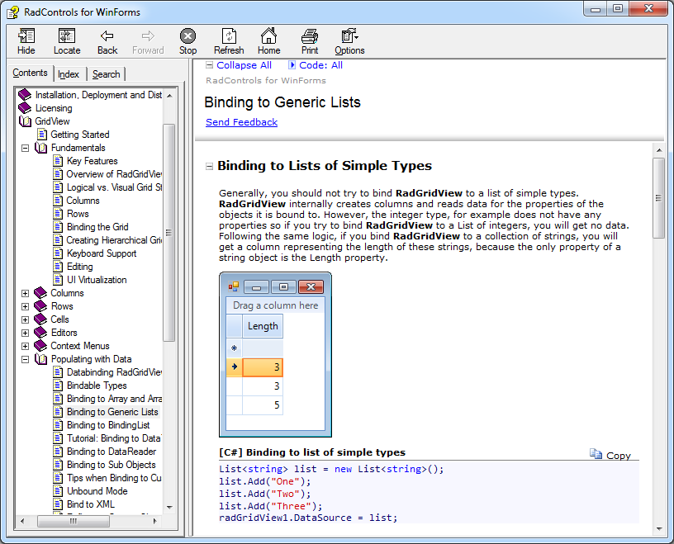
MS HTML Help 1.x (a.k.a CHM)
CHM is a help documentation compiled and saved in a compressed HTML format - may include text, images, and hyperlinks.
It is a stand alone file.
Shipped 1997 as part of IE4
MS used it for help of VS6

Slide 6
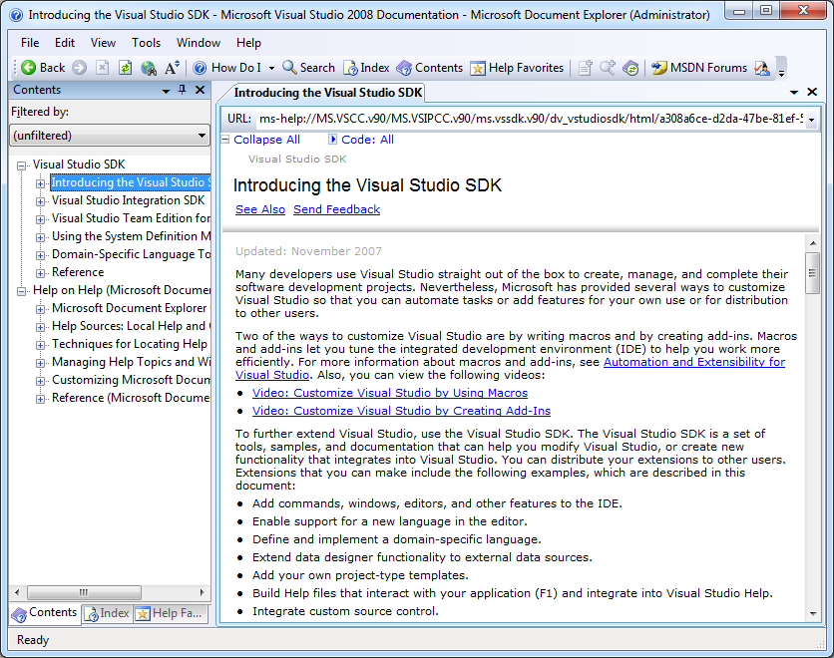
MS HTML Help 2.x (a.k.a Help2)
MS Help 2 is the help system used by Visual Studio .NET help and MSDN Library, and now the Borland .NET
Announced at 2001 WinWriters Conference
Used in VS 2002/2003/2005/2008

Slide 7
MS Help Viewer 1.0 (a.k.a Help3 )
MS Help Viewer is the new help engine for Visual Studio 2010 (version 10) and beyond. It replaces MS Help 2.x.
Sep 2010 Microsoft releases Help Viewer 1.0
MS Help Viewer 1.0 consists of:
Help Library Manager - Application for installing, uninstalling, updating help content.
Help Library Agent - Application associated with ms-xhelp:// protocol. Opens H3 URLs in the default web browser. Monitors Help 3 links like http://127.0.0.1/help/1/ and fetches and serves up the correct page from the data store.

Slide 8
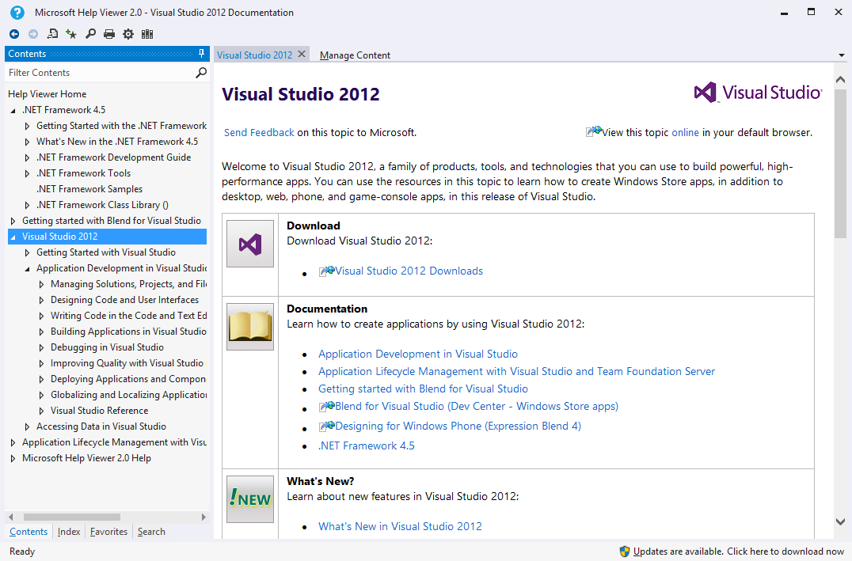
MS Help Viewer 2.0
Available in MS Visual Studio 2012
Support for Help3 documentation

Slide 9

How do we build all these help resources?

Slide 10
Sandcastle
Sandcastle is an open source documentation generator from Microsoft that automatically produces MSDN style reference documentation out of reflection information of .NET assemblies and optionally, XML documentation comments found in the source code of these assemblies. It can also be used to produce compiled user documentation from Microsoft Assistance Markup Language (MAML) with the same look and feel as reference documentation.

Slide 11
Sandcastle Help File Builder

Slide 12
Sandcastle Help File Builder (1)
A standalone GUI that provides Visual Studio like project explorer that lets you manage and edit associated files
The builder can produce an HTML Help 1 (.chm) file, an MS Help 2 (.HxS) file, MS Help Viewer (.mshc), and/or a website.
The settings are saved in a standard MSBuild-format project file and can be built from within the standalone GUI, from the command line using MSBuild, or in a post-build step for a Visual Studio project that runs MSBuild.

Slide 13
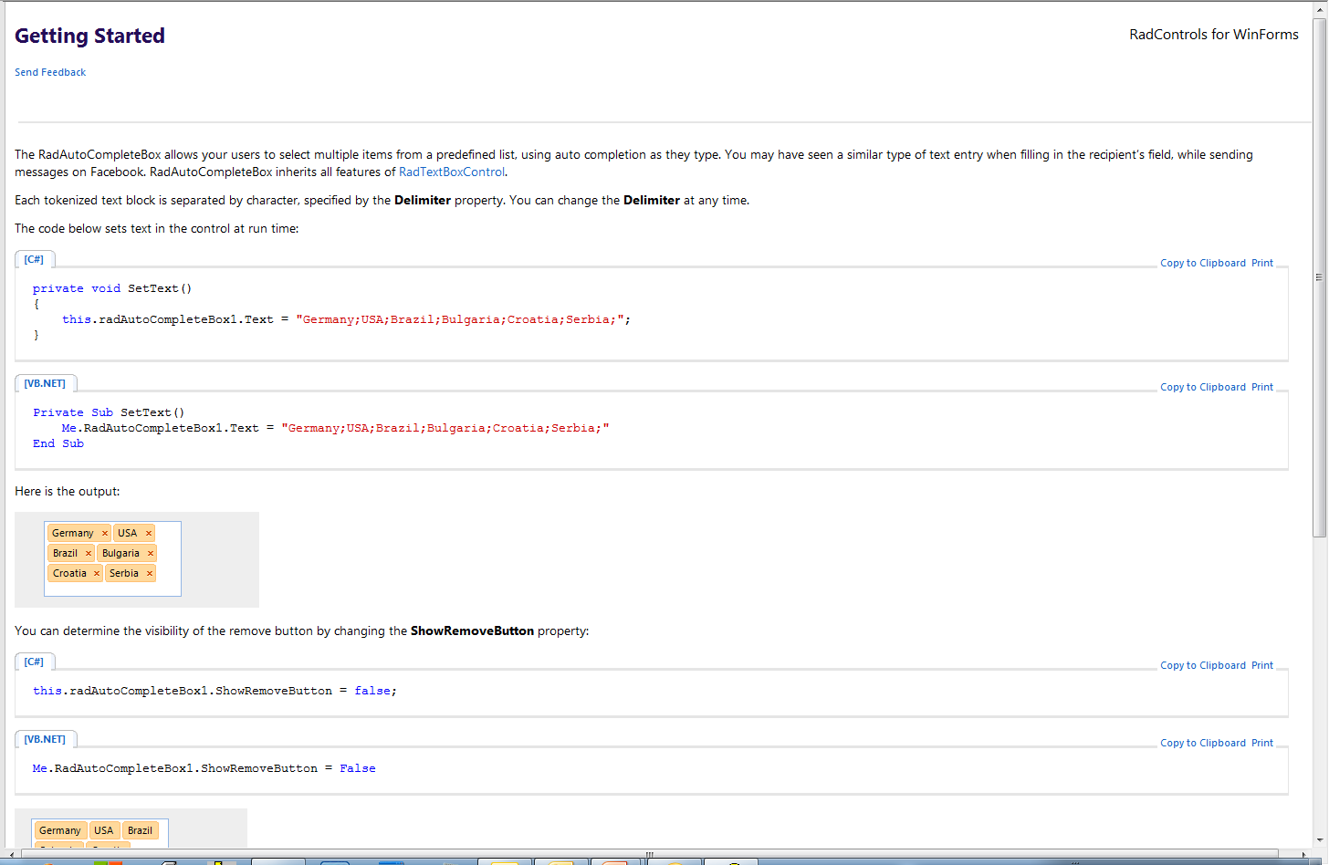
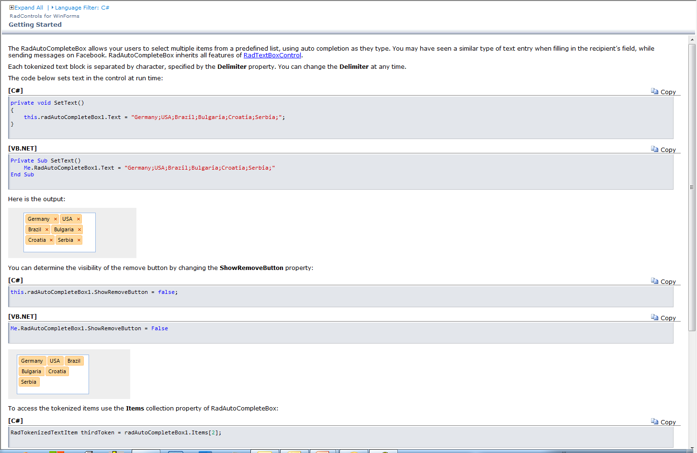
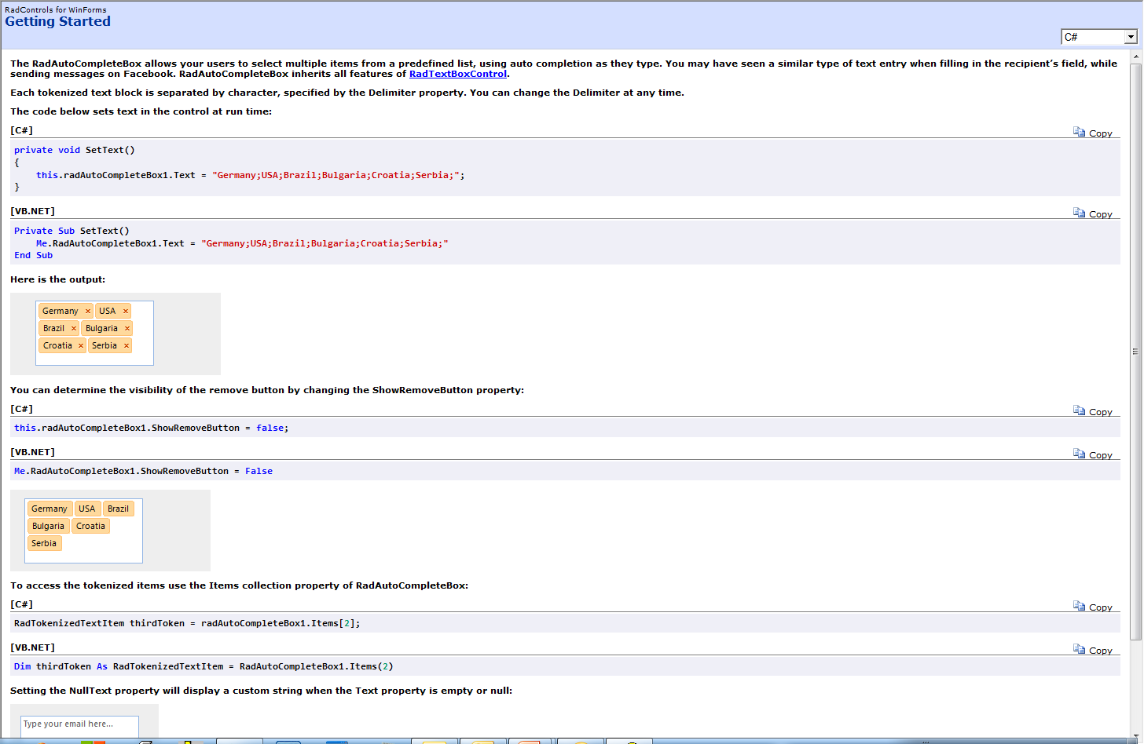
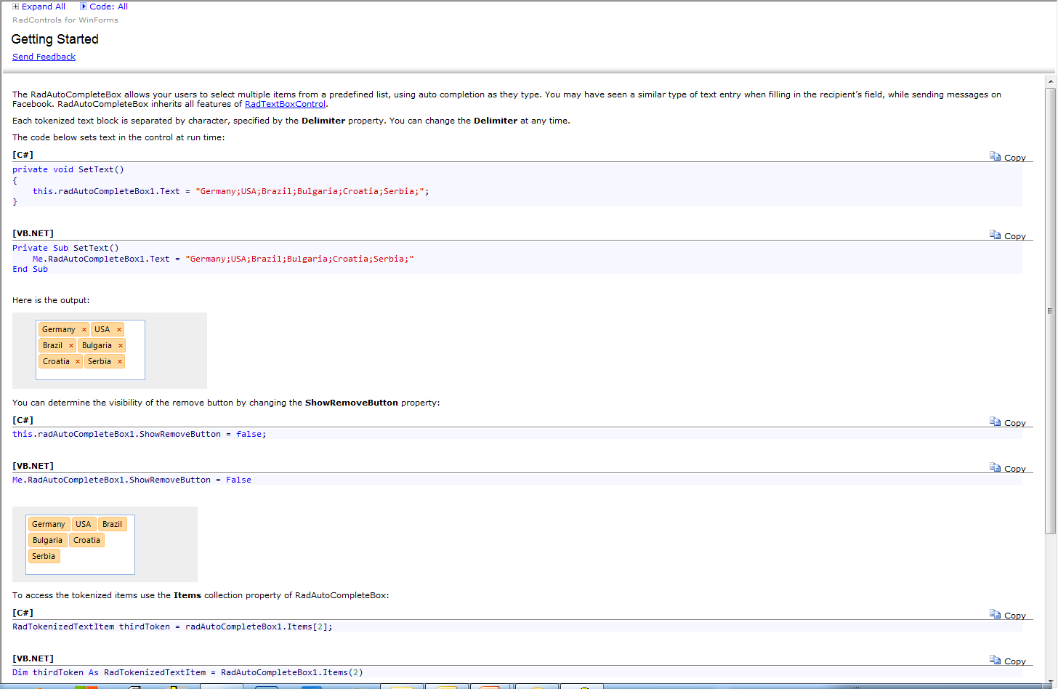
Sandcastle Help File Builder (2)
Customizable – several presentation styles
VS2010
Hana
Prototype
VS2005

Slide 14
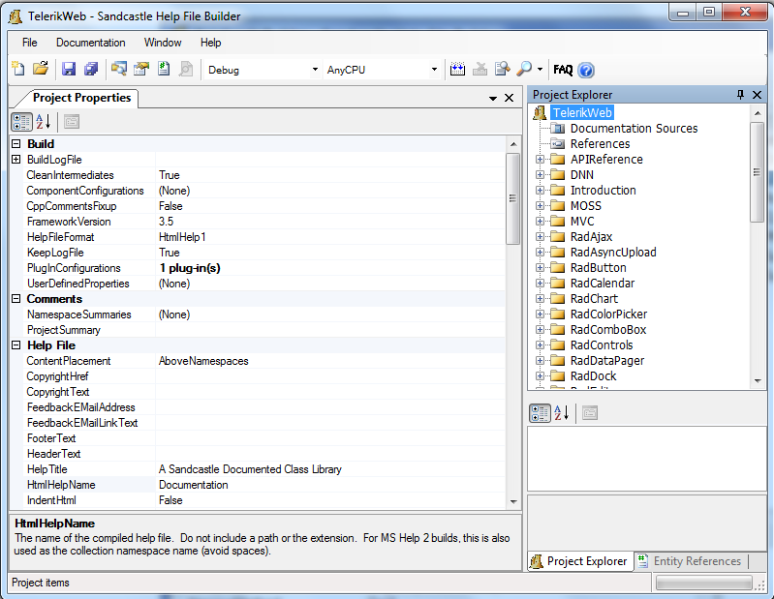
SHFB – First look

Slide 15
Menu bar
Menu bar

Slide 16
Menu bar (1)
The File menu provides access to the various project and file related commands such as
Creating a new project, saving the project and etc.
The Documentation menu contains the commands used to build the help file
The Window menu contains the commands used to show the various task windows and jump to any of the open topic or file editors
The Help menu allows you to open the help file, view the FAQ help topic, and view product version and copyright information

Slide 17
Project Explorer
Project Explorer

Slide 18
Project Explorer (1)
The Documentation Sources node is where you will specify the assemblies and XML comments files. You can omit this by adding “Additional content only” plugin.
The References node is where you specify dependent assemblies
Folder nodes can be created to organize the file content of the project
File nodes represent conceptual content topics, images, content layout files, and other files that may or may not be compiled into the help file

Slide 19
Project properties
Project Properties Window
Allows you to set various properties concerning the documentation appearance and the different build types.

Slide 20
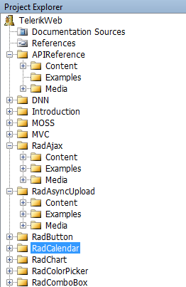
The structure of our projects
Each root folder contains two main subfolders:
Content
Media
Examples (optional)
Notes:
Examples is used in certain teams

Slide 21
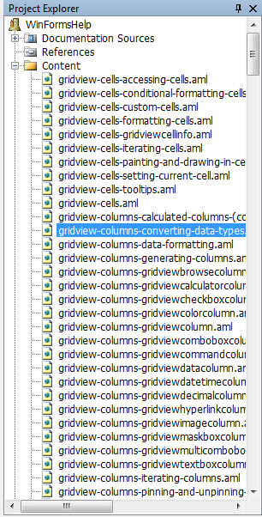
Content folder
Content folder contains conceptual topics (for the whole suite or for a particular control.
Topic files contain Microsoft Assistance Markup Language (MAML) to define non-reference content such as usage notes, walkthroughs, tutorials, etc.
MAML topic files have .aml extension and should have their BuildAction set to None in the Project Explorer

Slide 22
Topic filenames and location
Each .aml file should have as a prefix the name of the control to which the file belongs. For example:
grid-accessing-cells-and-rows
editors-textbox-getting-started
You can arrange .aml files on disk to match the layout in the table of contents and give them meaningful names to aid in managing them outside of the project and the designer

Slide 23
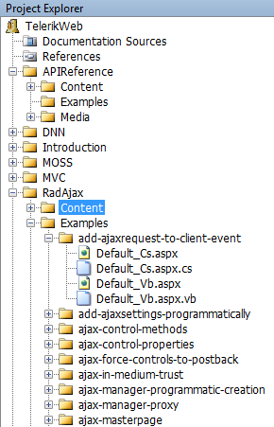
Examples folder
Examples folder contains files with source for for each topic:
Default_Cs.aspx – you can add JavaScript and CSS code here as well
Default_Cs.aspx.cs – C# code examples
Default_Vb.aspx
Default_Vb.aspx.vb – VB.NET code examples

Slide 24
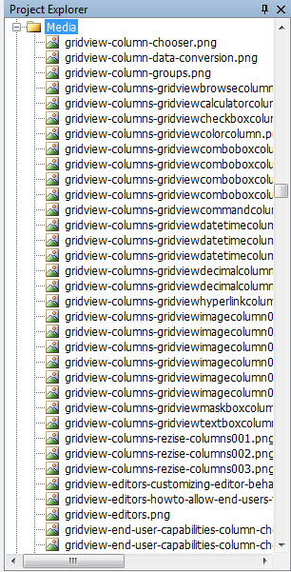
Media folder
Media folder contains all images linked into the content Similar to the topic files, the images are referenced by their ID, not name.

Slide 25
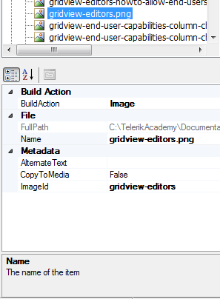
Media folder (2)
Build Action – needs to be set to Image
ImageId – Unique id for the image
The ID should be the as the aml file name + a number. For example:
gridview-editors001, gridview-edtiors002, etc
AlternateText – use this to set alt property of the rendered images

Slide 26
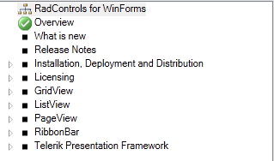
Content Layout File (.content)
Allows you to specify the conceptual content topics that will be included in the help file and define their layout in the table of contents
You can edit the content layout file from within the help file builder by double-clicking it in the Project Explorer window
The topics can be moved by drag-and-drop
Every *.content file should have a default document ( ) in order to build successfully
Help3 build requires a root container

Slide 27
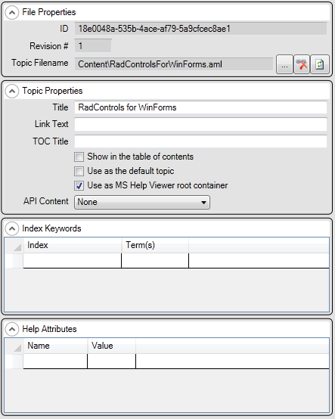
Content Layout properties
Each topic is assigned a unique ID that can be referenced in topics using a link MAML element
Each topic contains several properties. The most important are: Title and Show in TOC properties

Slide 28
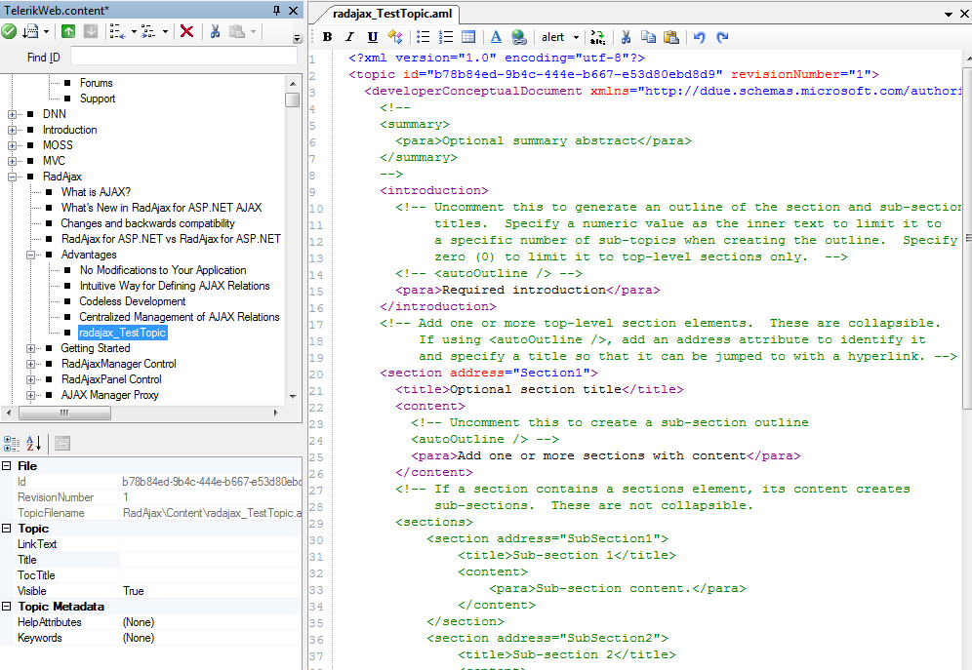
Text Editor
Toolbar options
Bold - Inserts a legacyBold element.
Italic - Inserts a legacyItalic element.
Underline - Inserts a legacyUnderline element
Code Inline - Inserts a codeInline element
Bulleted List - Inserts a bulleted list element with two default listItem elements
Numbered List - Inserts a numbered list element with two default listItem elements

Slide 29
Text Editor (2)
Table - Inserts a table element with a default table header and row
External link - Insert an externalLink element for linking to an outside target such as a website
Various elements dropdown - The dropdown will allow you to insert various MAML elements
HTML Encode - HTML encodes the currently selected text
Cut, Copy, and Paste - Standard Windows clipboard cut, copy, and paste operations
Undo and Redo - Undo and redo edits

Slide 30
Text Editor (3)
Drag and Drop
The text editor window also supports drag and drop operations from the Content Layout Window to insert links to other topics in the project (just Drag-And-Drop a node from the .content explorer to an opened *.aml file).
Drag and drop from the Entity References Window to insert token references, image links, code entity reference links
Preview Topic
Select the Preview Topic option on the Window menu, click the related main toolbar button, or hit F5

Slide 31
Tags

Slide 32
Tags (1)
These are the most often used tags:
<introduction>
<section> - Determines a section. Has 2 properties:
<title>
<content> - May contain other <section> elements
<para> - paragraph
<alert class=“value”> - highlighted region. The value can be :
note
caution
security
cs - This could contain C#-specific usage notes
<list class=“value”> and <listItem> - a possible values that can be set to the class property are: bullet and ordered Example: <list class="bullet"> <listItem> Item 1</listItem>
<listItem> Item 2</listItem> <listItem> Item 3</listItem> </list >
<link xlink:href =“GUID”> Optional InnerText</link > - The xlink:href attribute should contain a n existing GUID of the topic to which the link will go and optional inner text
<externalLink> - Link to external resources. Required attributes are: linkText and linkUri
Example: <externalLink>
<linkText> Sandcastle Styles</linkText>
<linkAlternateText> Visit Sandcastle Styles</linkAlternateText> <linkUri>http://www.codeplex.com/SandcastleStyles</linkUri>
<linkTarget>_self</linkTarget>
</externalLink>

Slide 33

Tags (2)
<relatedTopics> - AKA SeeAlso section Example: <relatedTopics topicType_id="1FE70836-AA7D-4515-B54B-E10C4B516E50">
<link xlink:href="700D89B9-A5C9-4281-8651-3CEB407C3648" />
<externalLink>
<linkText> Telerik</linkText> <linkUri>http://www.telerik.com</linkUri>
<linkTarget>_blank</linkTarget>
</externalLink>
</relatedTopics>
Description: - The value of the id attribute determines the type of the SeeAlso section. There are 19 types, but the one set in the example above is fairly enough (it will produce a title named: “Other Resources”)
- <link> and <externalLink> elements can be used as shown in the example
Output:
<legacyBold> Bold text</legacyBold> (Available as ToolBar command)
< legacyItalic > Italic text</ legacyItalic> (Available as ToolBar command)
< legacyUnderline> Underline</ legacyUnderline > (Available as ToolBar command)
<literal>Highlight text</literal> - highlights the text between the opening and closing tags
<markup> </markup> - wraps a HTML content

Slide 34
Tags (3)
<mediaLink> and <mediaLinkInline>- add images to the document using this tag. The mediaLinkInline tag does not have <caption> Example: <mediaLink>
<caption> Image caption</caption>
<image xlink:href=“ImageID"/>
</mediaLink>
<table> - This element is used to arrange data in a table format with rows and columns. <title> and <tableHeader> are optional Example: <table>
<title> Optional Title</title>
<tableHeader>
<row>
<entry> Header 1</entry>
<entry> Header 2</entry>
<entry> Header 3</entry>
</row>
</tableHeader>
<row>
<entry> Row 1, Cell 1</entry>
<entry> Row 1, Cell 2</entry>
<entry> Row 1, Cell 3</entry>
</row>
<row>
<entry> Row 2, Cell 1</entry>
<entry> Row 2, Cell 2</entry>
<entry> Row 2, Cell 3</entry>
</row>
</table>

Slide 35
Code snippets

Slide 36
Code snippets
The <code> tag should be used in to show example code:
<code source="Examples\CodeSource.cs“ lang="C#"
title="C#"
region=“regionName“>
</code>
source – the path to the file which contains the code
lang – language of the code snipped (case insensitive). These are some of the supported values:
C#, CSharp, cs
VisualBasic, VB
JavaScript, js
XML
ASPNET
title – this will appear as title of the snippet
region – name of the region that wraps the code snipped

Slide 37
Code snippets – example (1)
C#
Code reference in *.aml file: <code source="Examples\CodeSource.cs"
lang="C#"
title="C#"
region=" CsRegionName ">
</code>
A part of the CodeSource.cs file’s content: #region CsRegionName
public string GetString()
{
return string.Empty;
}
#endregion
VB.NET
Code reference in *.aml file: <code source="Examples\CodeSource.vb"
lang=“VB"
title=“VB"
region=" VbRegionName ">
</code>
A part of the CodeSource.vb file’s content: #Region "VbRegionName"
Protected Sub Page_Load(ByVal sender As Object, ByVal e As System.EventArgs) Handles Me.Load
End Sub
#End Region

Slide 38
Code snippets – example (2)
XML (ASP in particular)
Code reference in *.aml file: <code source="Examples\CodeSource.aspx"
lang=“ASPNET"
title=" ASP.NET "
region=" AspRegionName ">
</code>
A part of the CodeSource.aspx file’s content: <!-- #region AspRegionName -->
<telerik:RadGrid ID="RadGrid1" runat="server" Width="95%" Skin="Vista" AllowSorting="True"
DataSourceID="AccessDataSource1" AllowPaging="True" PageSize="5"
OnItemCreated="RadGrid1_ItemCreated"></telerik:RadGrid>
<PagerStyle Mode="Advanced" />
<MasterTableView Width="100%" DataSourceID="AccessDataSource1" />
</telerik:RadGrid>
<!-- #endregion -->
JavaScript
Code reference in *.aml file: <code source="Examples\CodeSource.js"
lang=“JavaScript"
title=“JavaScript"
region=" JsRegionName ">
</code>
A part of the CodeSource.js file’s content:
//#region JsRegionName
function getSelLangCoockie()
{
return readCookie("tcbCoockieKey");
}
// #endregion

Slide 39
Code tabs

Slide 40
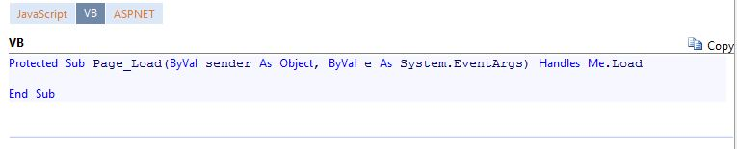
Code tabs (1)
We have implemented a custom tag called tabbedCode. It generates a tab for every code element.
Note that this component is separately installed.
<tabbedCode>
<code source="Examples\CodeSource.aspx"
lang="JavaScript"
title="JavaScript"
region="JsRegionName">
</code>
<code source="Examples\CodeSource.vb"
lang="VB"
title="VB"
region="VbRegionName">
</code>
<code source="Examples\CodeSource.aspx"
lang="ASPNET"
title="ASP.NET"
region="AspxRegionName">
</code>
</ tabbedCode >

Slide 41
How to create a new topic?

Slide 42
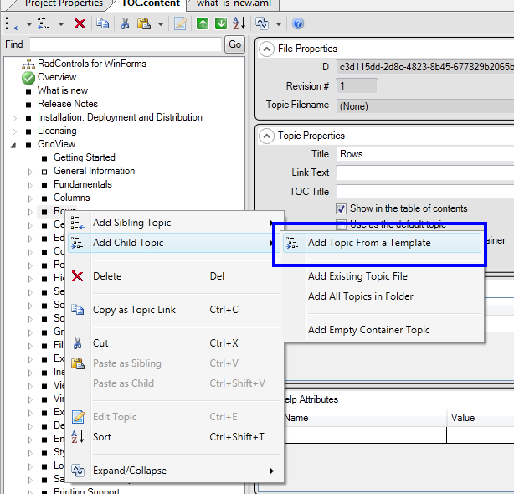
Create new topic (1)
Right click on the desired node in the content layout window and select Add Child/Sibling Topic > Add Topic from a Template:

Slide 43
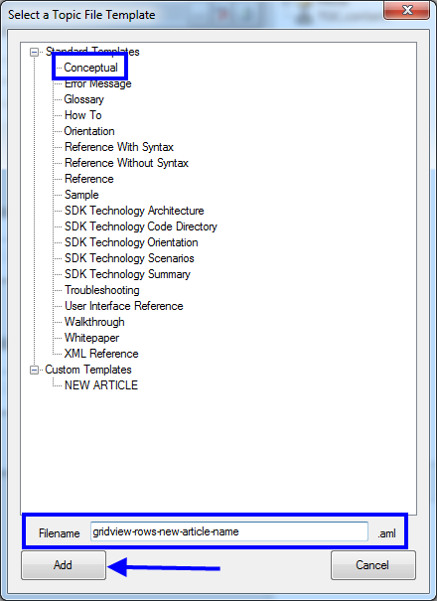
Create new topic (2)
Choose the Conceptual template
Add appropriate name (starting with control-section-articlename.aml)
Click the Add button
The file is automatically added to your Content directory

Slide 44
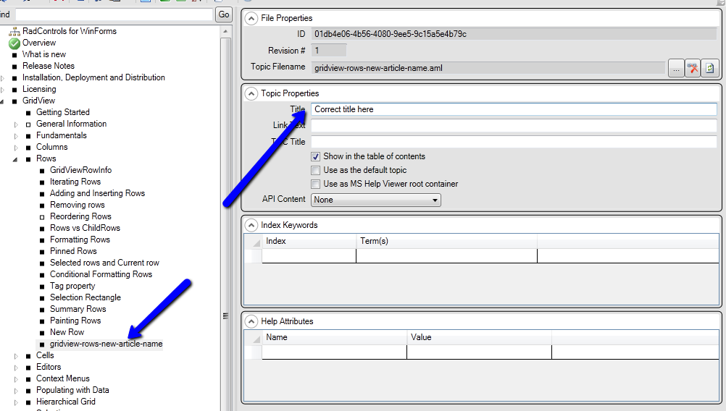
Create new topic (3)
Once added, don’t forget to change the title to a more user friendly name

Slide 45
How to add image?

Slide 46
Add an image
In order to add an image, simply name it according to the accepted pattern (the same as the article filename + a number 001, 002, etc)

Slide 47
How to generate API Reference?

Slide 48
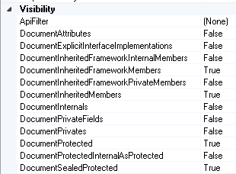
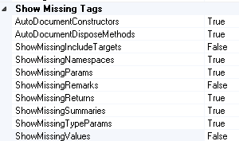
Generate API Reference
Sandcastle uses Reflection and the generated XML file to get the comments for each member in the assembly. You can control which of them to be visible. By default all public members are documented.

Slide 49
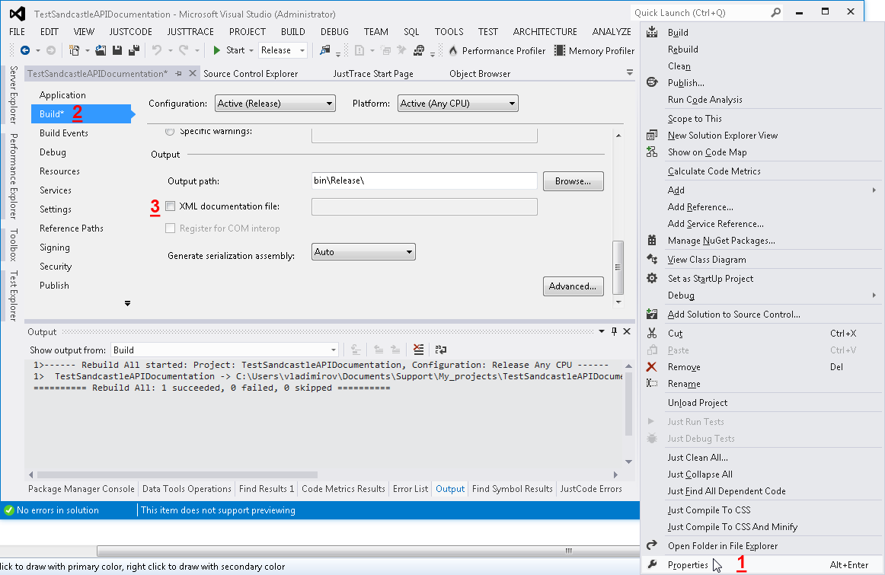
Generate API Reference (2)
In Visual Studio add XML documentation file to the Output

Slide 50
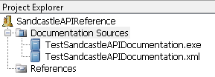
Generate API Reference (3)
Add the binaries as Documentation Sources.
Build the Project and in the output you will find documented all members (based on the values you’ve set)

Slide 51

DEMO
Notes:
Demonstrate the WinForms sample project in SHFB

Slide 52
http://academy.telerik.com

Slide 53
Visual Studio extension package

Slide 54
Visual Studio extension package (1)
Visual Studio 2010 and 2012 extension packages
Allows you to create, manage and build projects from within Visual Studio
Easier integration with TFS
Documentation: http://www.ewoodruff.us/shfbdocs/Index.aspx?topic=html/8c0c97d0-c968-4c15-9fe9-e8f3a443c50a.htm

Slide 55
Visual Studio extension package (2)
Pros
Easier integration with TFS – you do not need to go back a forth between SHFB and TFS
You can use the Visual Studio text editor
Easy Preview
Cons
Slow with bigger projects

Slide 56
DEMO
Notes:
Demonstrate the WinForms sample project in Visual Studio

Slide 57
http://academy.telerik.com

Slide 58
Get started
Install Sandcastle
Install SHFB
Connect with TFS
Get acquainted with the existing project
Notes:
Server Name: tfs.codeplex.com
Path: tfs
Port number: 443
Protocol: https
Project Collection: TFS02
Project Name: devsupport
Username: snd\checho_85_cp
Password: <same as your website password>

Slide 59
http://academy.telerik.com

Slide 60
What’s next?
Notes:
Demonstrate the WinForms sample project in Visual Studio

Slide 61
Markdown
Markdown is a lightweight markup language, originally created by John Gruber with substantial contributions from Aaron Swartz, allowing people “to write using an easy-to-read, easy-to-write plain text format, then convert it to structurally valid XHTML (or HTML)”.
Markdown is also a Perl script written by Gruber, Markdown.pl, which converts marked-up text input to valid, well-formed XHTML or HTML

Slide 62
Markdown (2)
Markdown resources:
http://daringfireball.net/projects/markdown/
http://daringfireball.net/projects/markdown/syntax#link
http://en.wikipedia.org/wiki/Markdown
Kendo Documentation is using Markdown + Sitefinity
http://docs.kendoui.com/

Slide 63
Markdown vs. MAML
Sandcastle uses MAML. The build process is very slow, no matter what are the changes in the articles.
With Markdown, the Help files can be stored at github and there is integrated viewer for the content. Any changes will be applied immediately.
Markdown’s syntax is simpler than MAML.

Slide 64
Assignment
Create a new project with the default sample conceptual topic. Preview the topic in the chosen tool (VS or SHFB).
Add some content to the conceptual file and preview it in the previewer window.
Add three child topics to the existing conceptual topic with some content in it. Use most of the tags and also use images.

Slide 65
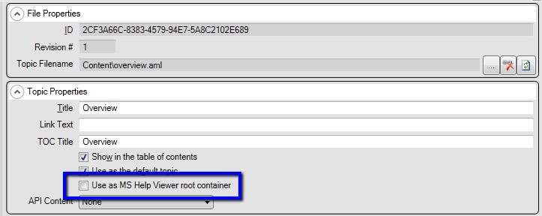
Assignment (2)
Add a sample assembly as documentation source and build all help formats.
Note: Help 3 requires to add a new node to the TOC file as a root container:

Slide 66
Resources
http://www.mshelpwiki.com/wiki/tiki-index.php?page=Help2
http://helpware.net/
http://en.wikipedia.org/wiki/Main_Page
http://shfb.codeplex.com/
http://sandcastle.codeplex.com/

Slide 67
http://academy.telerik.com

